Slide 1
Attendance Management System Using RFID Technology
Presented by
K.Manasa
B.Sai Teja
K.S.B.S.SaiKrishna
N.Hari Vamsi Krishna
Batch Id:[6A]
Project Guide: T.Anitha Ma’am

Slide 2
Base Paper
IEEE Symposium on Industrial Electronics and Applications. RFID Based Attendance System T.S. Lim, S.C. Sim and M.M. Mansor Faculty of Engineering and Technology, Multimedia University.

Slide 3
Abstract
The conventional method of taking attendance by calling names or signing on paper is very time consuming and insecure, hence inefficient. Radio Frequency Identification (RFID) based attendance system is one of the solutions to address this problem.
With real time clock capability of the system, attendance taken will be more accurate since the time for the attendance taken will be recorded.

Slide 4
Abstract..
Radio frequency identification (RFID) refers to the use of radio frequency wave to identify and track the tag implanted into an object or a living thing.
RFID system usually consists of RFID reader and tag. It is very useful because it can uniquely identify a person or a product based on the tag incorporated.

Slide 5
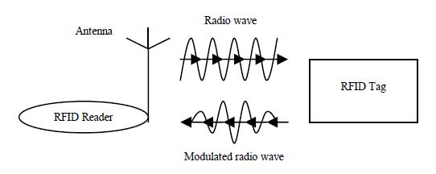
Basic operation of RFID system

Slide 6
Architecture

Slide 7
References
S.Shepard, “RFID Radio Frequency Identification”, s.l.: MacGraw-Hill, 2005.
Radio-frequency identification. Wikipedia (online). Wikimedia Foundation, Inc., 2009.

Slide 8
Thank You…

Slide 9


Extension of the System
We can use a ultra-high frequency RFID Reader, as a result the frequency of the reader will be high and the radius covered by it will be more so that the tag need not be shown to the sensor.

Slide 10
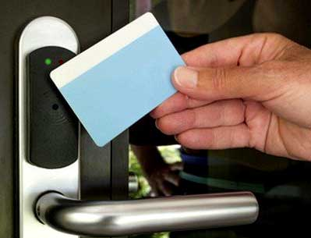
Extension of the System..
A secure lock system can be arranged to any doors and we can use RFID technology to unlock them without using any Key.

Slide 11

Extension of the System..
The proposed system will have an added specification in the form of Biometric in addition to the RFID.
We can maintain a buffer to store the data of the students who cannot access the biometric.

Slide 12

Extension of the System..
Automated SMS alerts will be sent to the parents of the students once they login to the biometric system.
The student will be marked absent if he/she fails to login or logout of the biometric system during the college timings (i.e., 8.40 AM – 3.20 PM).

